Slide 1
Image Denoising Using
LambdaNetworks
Loran Cheplanov, Roi Ben-Gigi

Slide 2
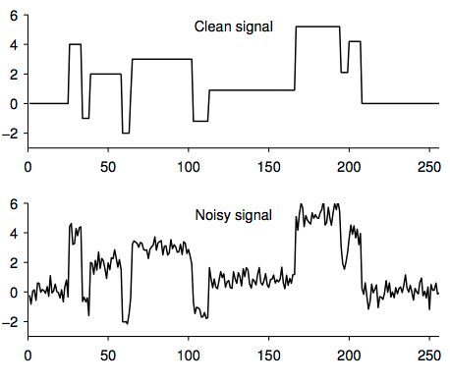
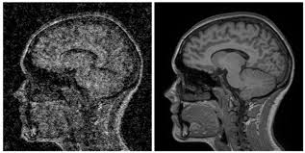
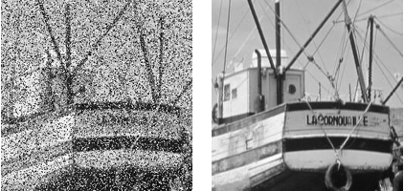
Motivation
Denoising – a popular mission in many areas:
Deep learning models’ main requirements: CPU(/GPU) and RAM
Expensive memory usage – restricts hardware capabilities
Our goal – create a model which provides good image denoising results while reducing the need for expensive RAM
Attention/Transformer models – excellent for gaining high accuracy results, but at the same time are very expensive

Slide 3
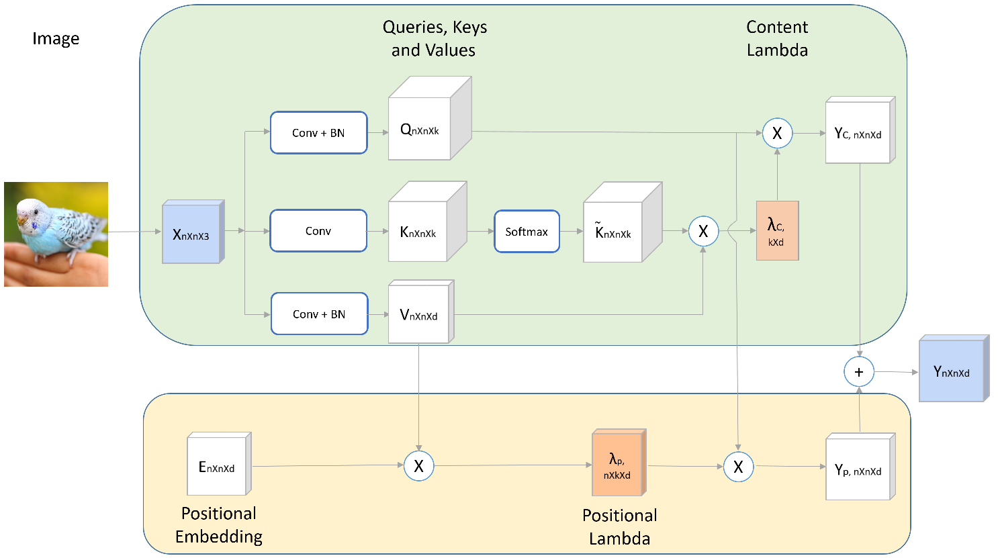
LambdaNetworks
A “Transformer” model-based, includes the self-attention mechanism
Gives a solution to the memory usage problem in the area of Classification
Bypasses the need for the expensive attention maps, Computationally efficient

Slide 4
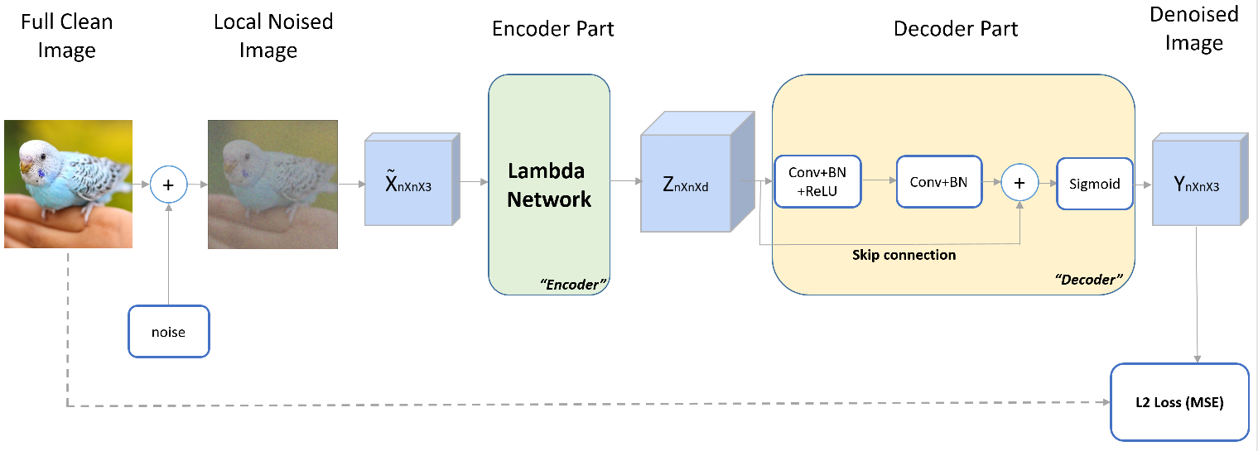
Our Proposed Model

Slide 5
Experiments
Methods and Settings
Results

Slide 6
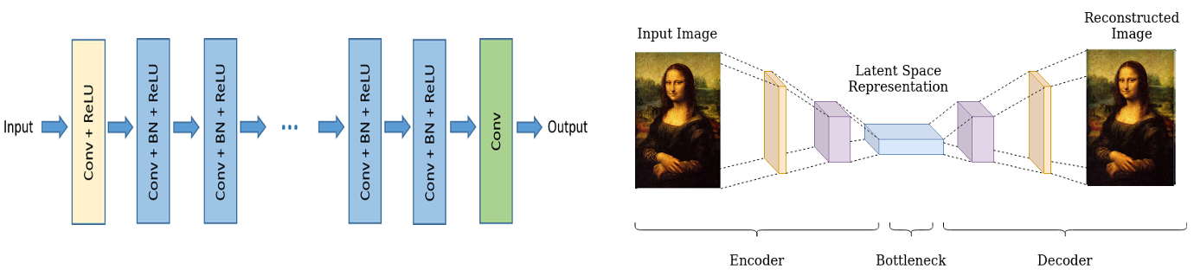
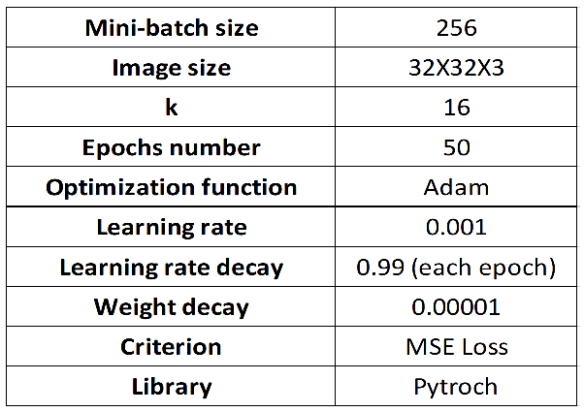

Experiments – Methods & Settings
The data –
Noise types: Gaussian ($σ$ = 0.1, 0.2, 0.3), Speckle, Salt & Pepper
Training dataset: CIFAR10
The comparable models –
Our models’ training table of hyper-parameters -
DnCNN
Denoising Auto-Encoder

Slide 7
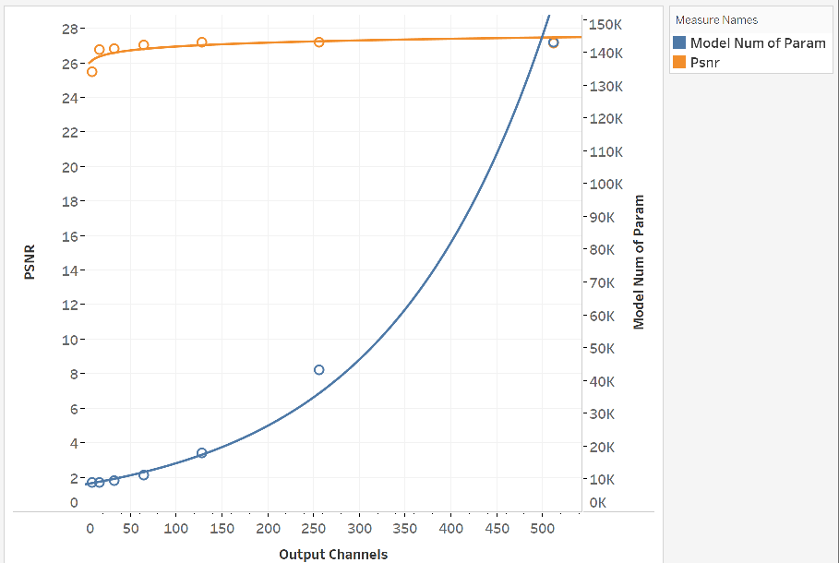
Experiments – Results
PSNR & Models’ Number of Parameters VS Encoders’ Output Channels

Slide 8
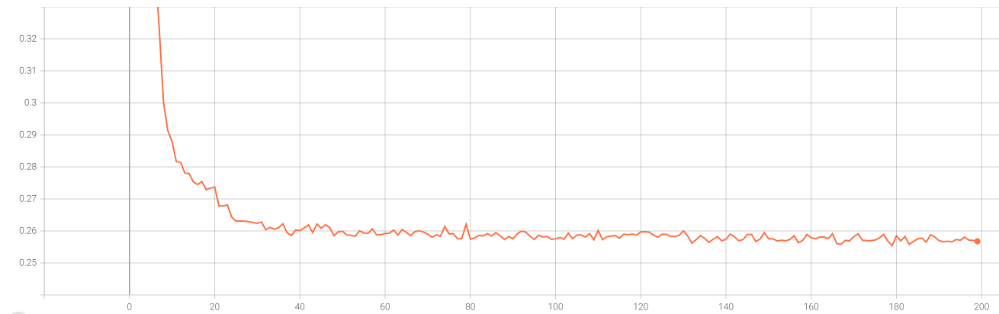
Experiments – Results
MSE
Epochs

Slide 9
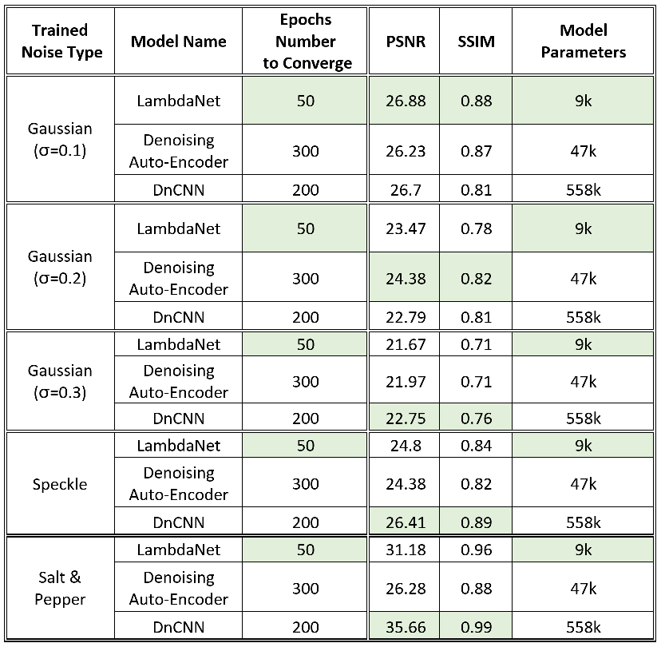
Experiments – Results

Slide 10


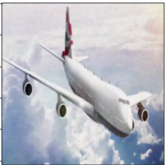
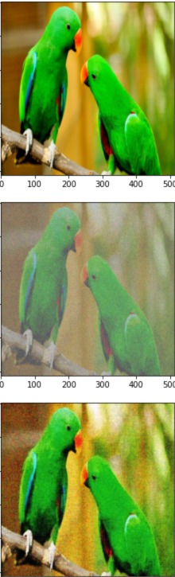
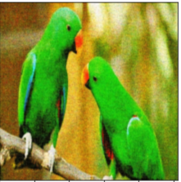
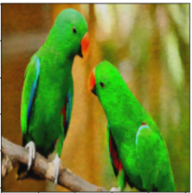
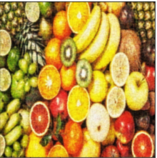
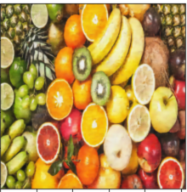
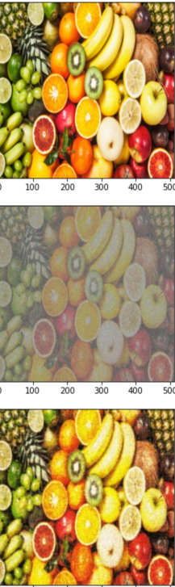
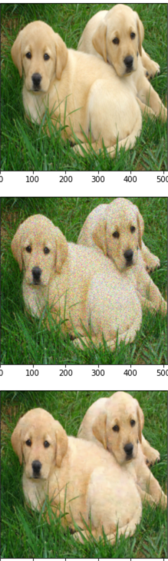
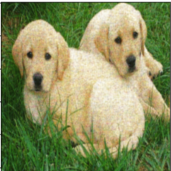
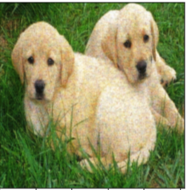
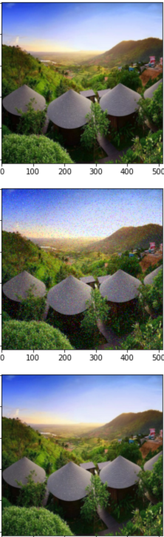
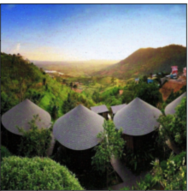
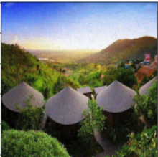



Experiments – Results
Original Image
Noised
Image
Output
LambdaNet
Output Denoising
Auto-Encoder
Output
DnCNN
Numeric results say that the best model is:
Similar
Denoising Auto-encoder, LambdaNet
DnCNN
DnCNN
DnCNN, LambdaNet
Gaussian Noise
$σ$ = 0.1
Gaussian Noise
$σ$ = 0.2
Gaussian Noise
$σ$ = 0.3
Speckle Noise
Salt & Pepper Noise

Slide 11
Conclusion and Further Work
Achievements:
Surprisingly very good denoising results
Significant reduction of memory usage
Fast training time (50 epochs)
Higher denoising results can be achieved with even deeper research.
Further Work:
Testing additional image corruption types
Using “transfer learning”
Using Layer normalization + higher batch size

